Slide 1








Sam Monteath
Data Analysis Portfolio
sam@reasonwhy.uk
github.com/SamMonteath
linkedin.com/in/sammonteath
public.tableau.com/app/profile/sam.monteath/vizzes

Slide 3

Overview
Case Study One: Video Game Trends
Case Study Two: Flu Season in the US
Case Study Three: Rockbuster Video
Case Study Four: Instacart Grocery Analysis
Case Study Five: AEP Time Series Analysis
Case Study Six: Test Match Cricket Data

Slide 4
Case Study One: Video Game Trends
I was asked to perform a descriptive analysis of a video game data set to foster a better understanding of how new games might fare in the market.
I needed to help understand:
● Are certain types of games more popular than others?
● What other publishers will likely be the main competitors in certain markets?
● Have any games decreased or increased in popularity over time?
● How have their sales figures varied between geographic regions over time?
See more: |  | Repository

Slide 5
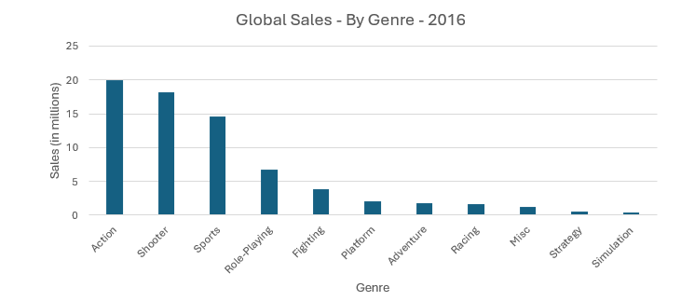
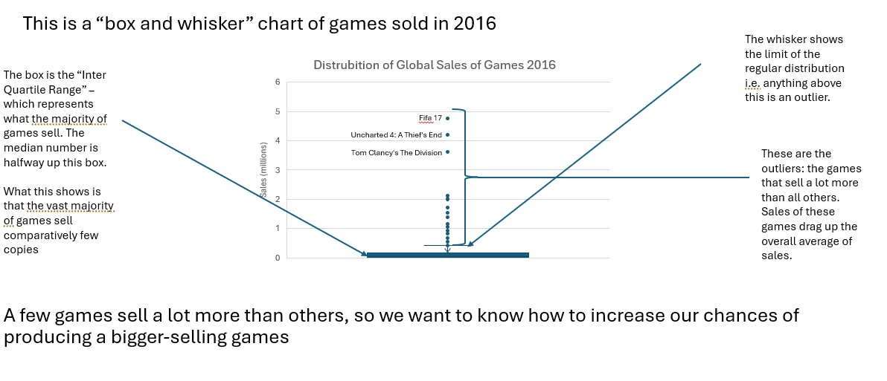
Case Study Two: Flu Season in the US
I reviewed, cleaned and understood the data so that I could begin analysis.
I started with simple analyses of trends.
More sophisticated analysis produced more interesting and useful results

Slide 6
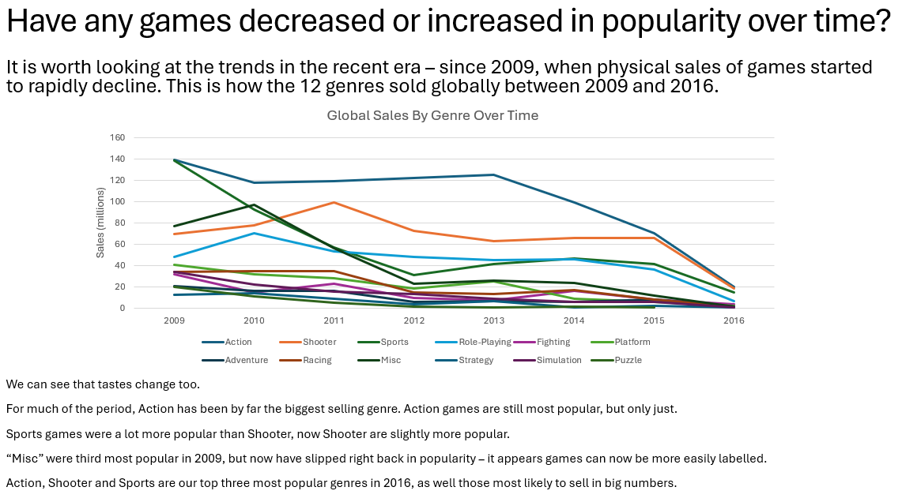
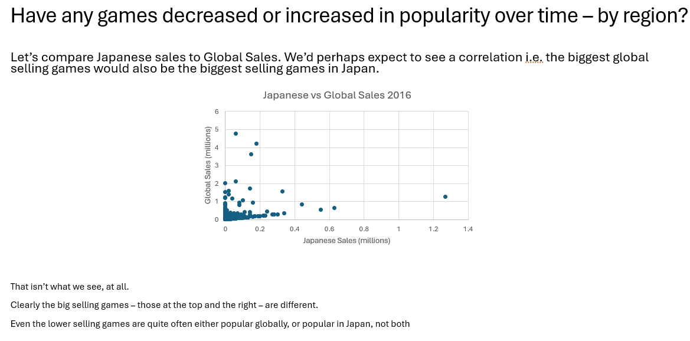
Case Study Two: Flu Season in the US
I carefully chose the visualisations that best showed the story of the data.
I made simple explanations of the most important points

Slide 7
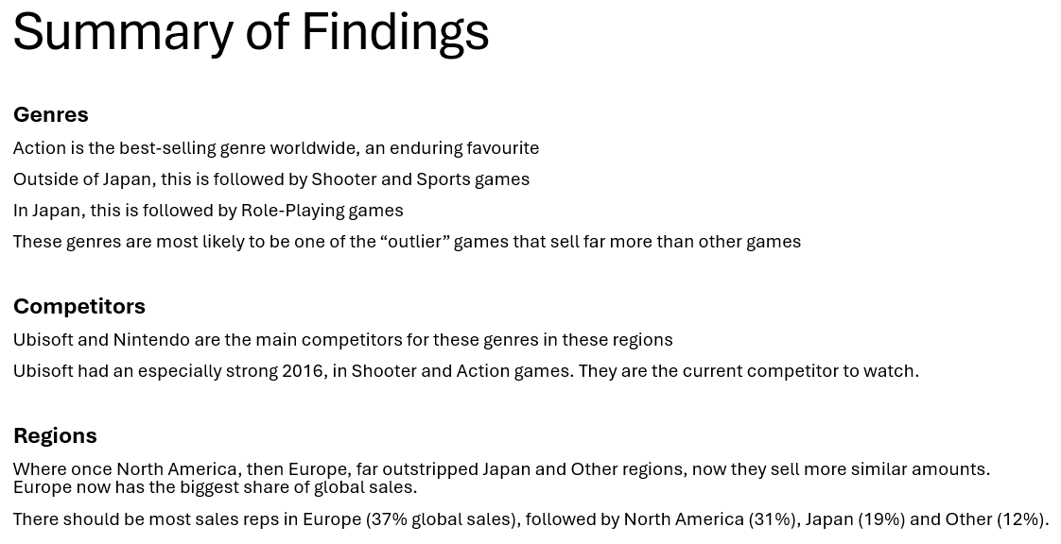
Case Study One: Video Game Trends
There was a huge amount of data to analyse.
By a careful process of following only the most useful insights, I was able to make a one-page set of recommendations.
See more: |  | Repository

Slide 8

Case Study Two: Flu Season in the US
Flu Season hits the US every year. It affects different areas with different intensities at different times.
This means it can be hard to know how to deploy resources to meet the need.
My task was to help with this question: When to send staff, and how many, to each state?
See more: |  | Visualisation
 |  | Presentation
 |  | Repository

Slide 9
Case Study Two: Flu Season in the US
I reviewed, cleaned, understood and performed initial analysis on the data, so that I could develop hypotheses.
I focused my detailed analysis on these three:
If a state is further north, then it is more likely to have higher rates of Flu in flu season
If a state has an older population, then it is more likely to have higher rates of death in flu season
If a state voted Trump in 2020, then it is more likely to have higher rates of Flu in flu season

Slide 10
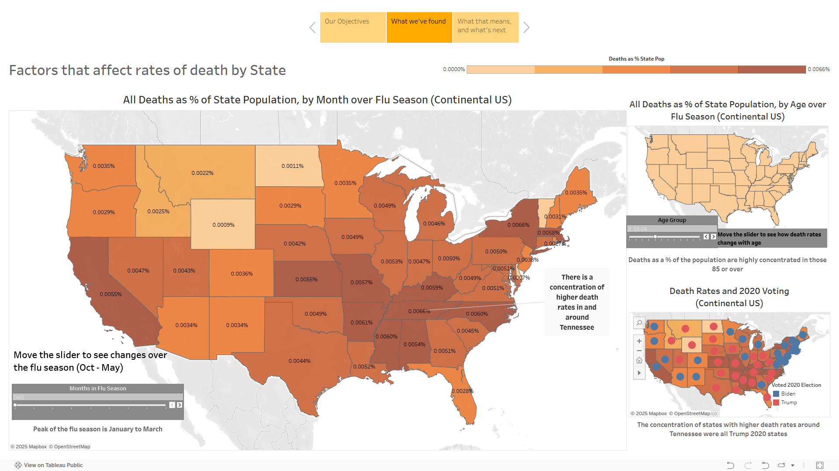
Case Study Two: Flu Season in the US
I created a Tableau dashboard to explore the data, and test these hypotheses:

Slide 11
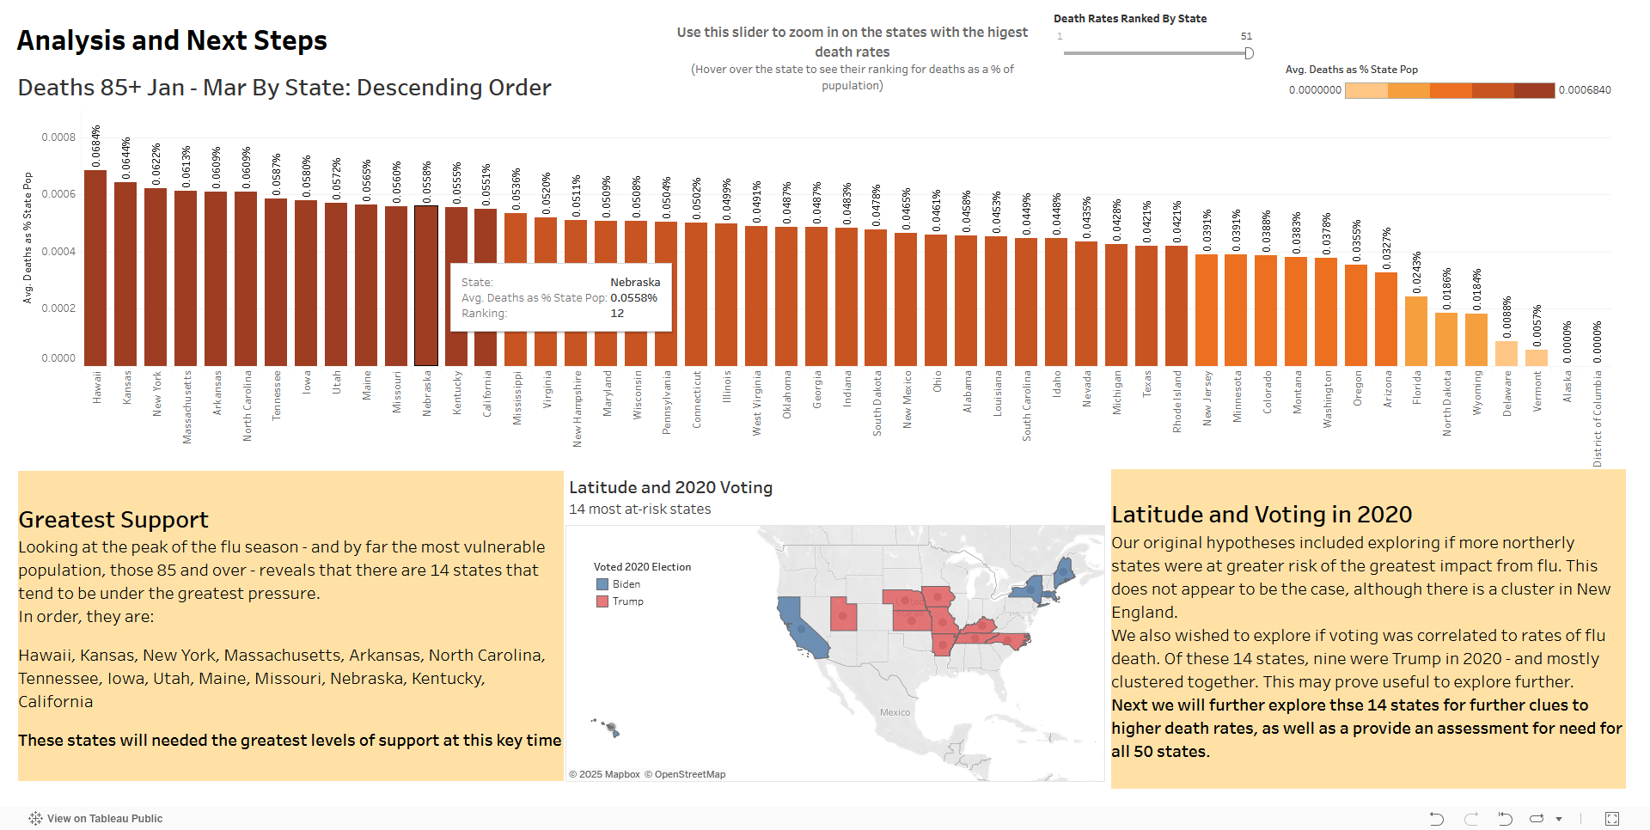
Case Study Two: Flu Season in the US
I was able to reject my hypothesis about more northern states being more at risk.
I did find a link between voting and risk of flu.
Vitally, I was able to identify 14 states that would be at greatest risk at the height of the flu season.
See more: |  | Visualisation
 |  | Presentation
 |  | Repository

Slide 12
Case Study Three: Rockbuster Video
Rockbuster were designing their new strategy – launching an online service to compete with Netflix.
They needed good data about their customers, including:
● Which movies contributed the most/least to revenue gain?
● What was the average rental duration for all videos?
● Which countries are Rockbuster customers based in?
● Where are customers with a high lifetime value based?
● Do sales figures vary between geographic regions?
See more: |  | Visualisation
 |  | Repository

Slide 13
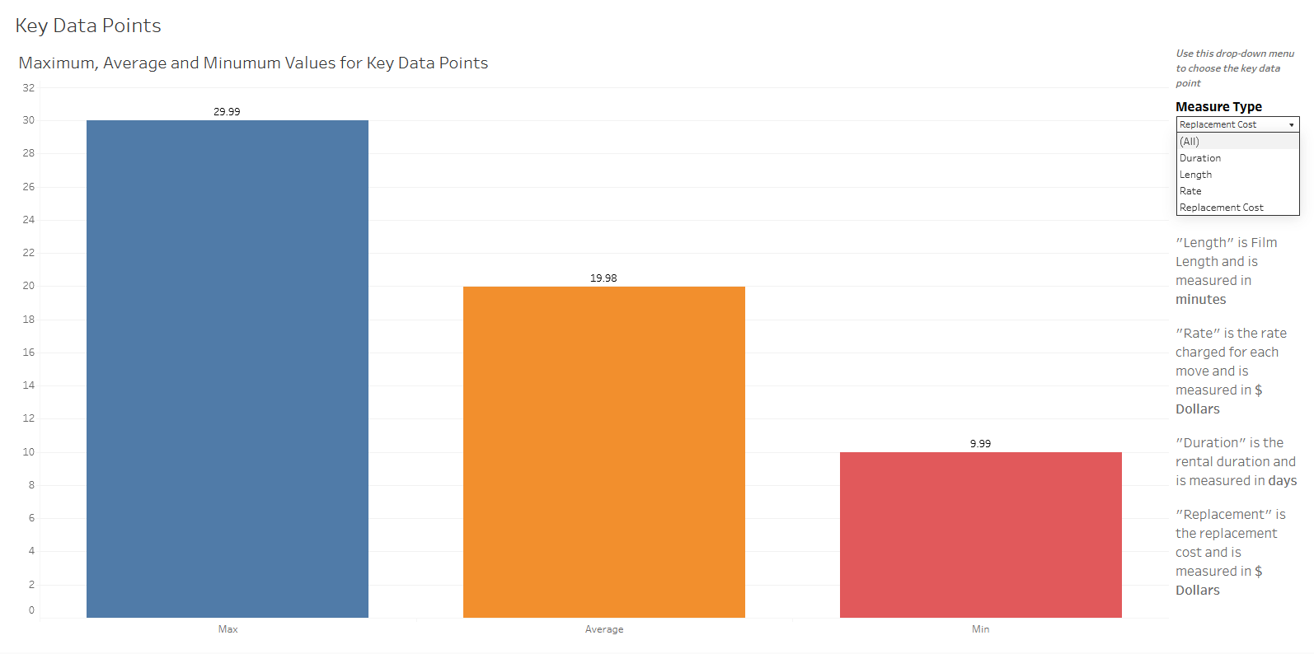
Case Study Three: Rockbuster Video
Using Tableau, I provided core data about their inventory, making it easy to access and explore

Slide 14
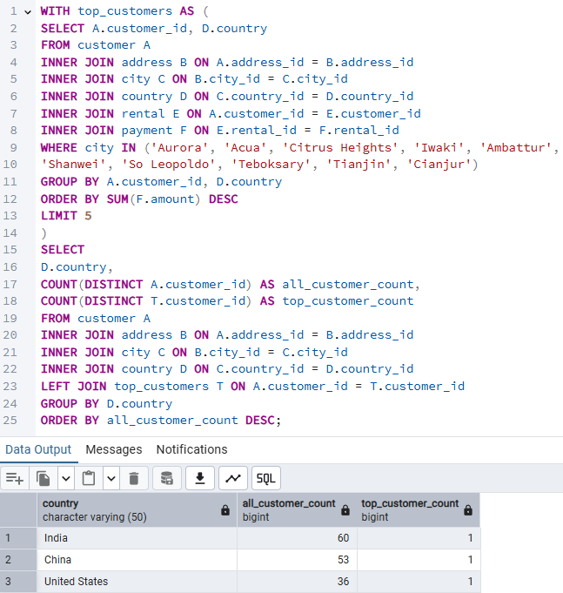
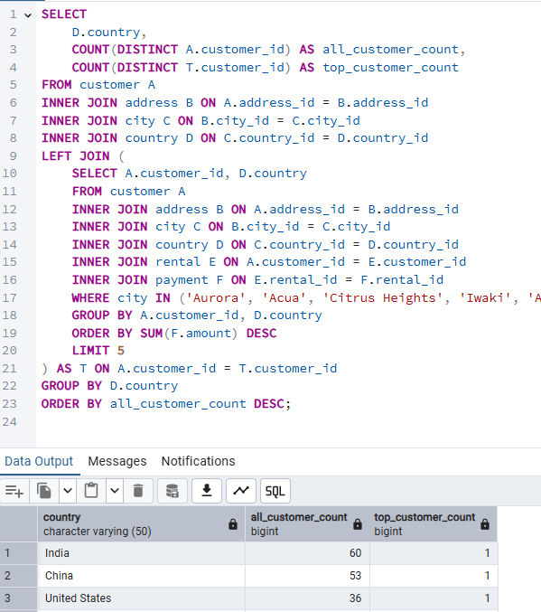
Case Study Three: Rockbuster Video
I performed the same analysis - finding the total customers in the countries of the top five spending customers – in two ways to find the most reliable and efficient method
The data was complex and, after cleaning, required joining and analysing in many different ways.
To do this I used Postgre SQL and a number of techniques including: Sub Queries and Common Table Expressions.
COMMON TABLE EXPRESSION
SUB QUERY

Slide 15
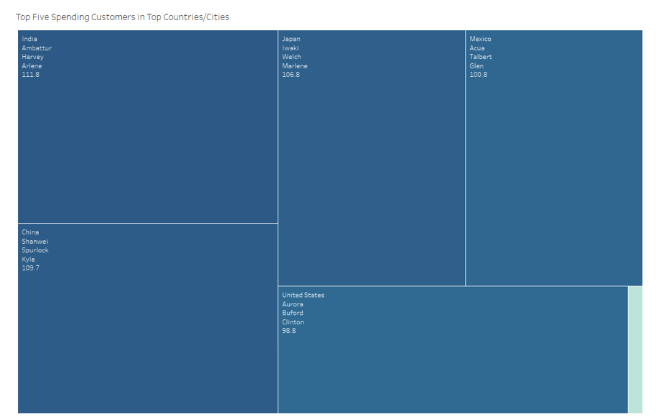
Case Study Three: Rockbuster Video
This enabled me to reveal that the average spend for a “Top Customer” was between $111.8 and $98.8 per person.
For comparison, the light blue area in the corner of this chart represents the average customer spend of just $4.20
If Rockbuster are to succeed, they need to follow the habits and preferences of these Top Customers
See more: |  | Visualisation
 |  | Repository

Slide 16
Case Study Four: Instacart Grocery Analysis
Instacart wanted to uncover more information about their sales patterns.
They needed good data about their customers, including:
When are they busiest?
When do people spend most money?
What types of products are most popular?
And of particular interest: Can they develop new categories of customers?
See more: |  | Repository

Slide 17
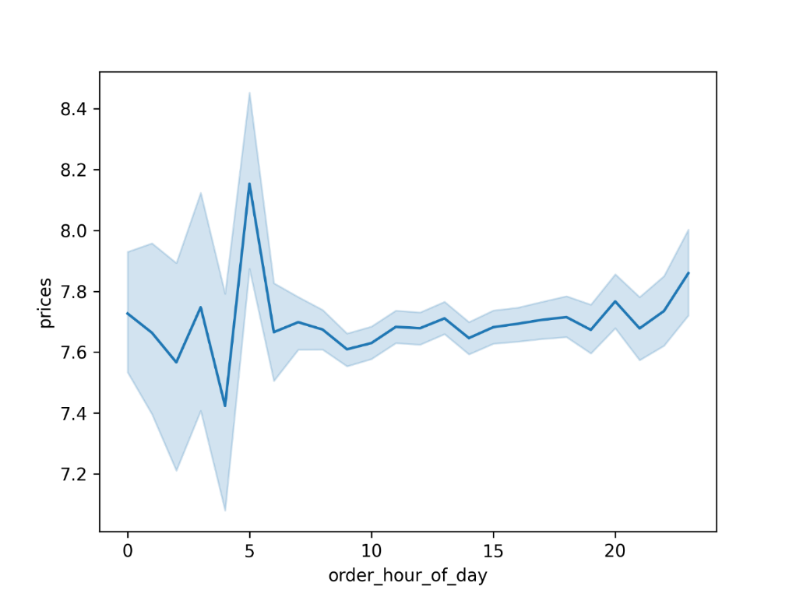
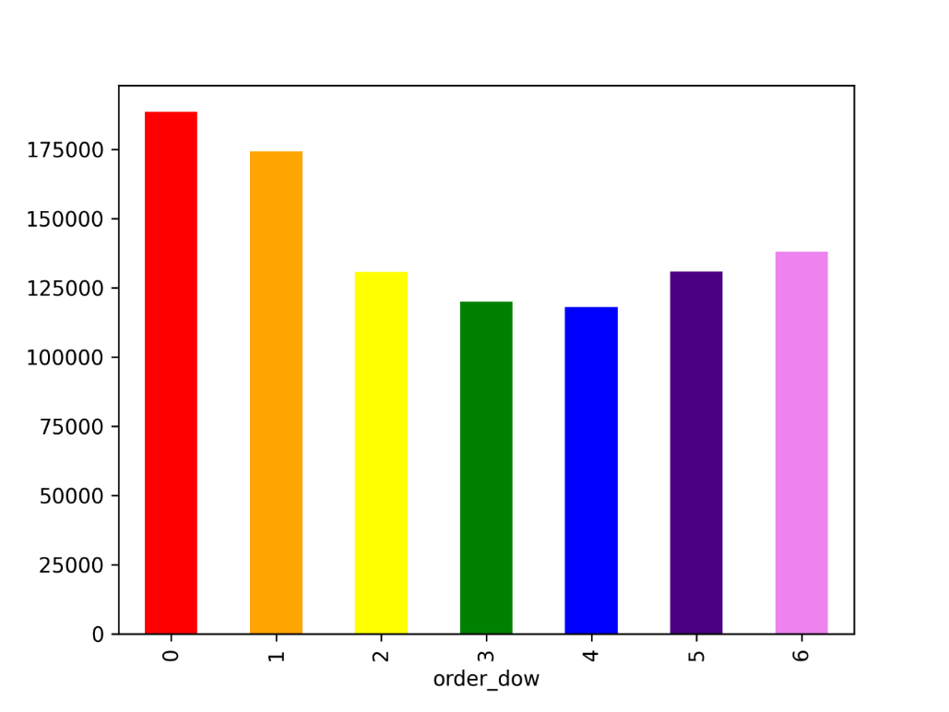
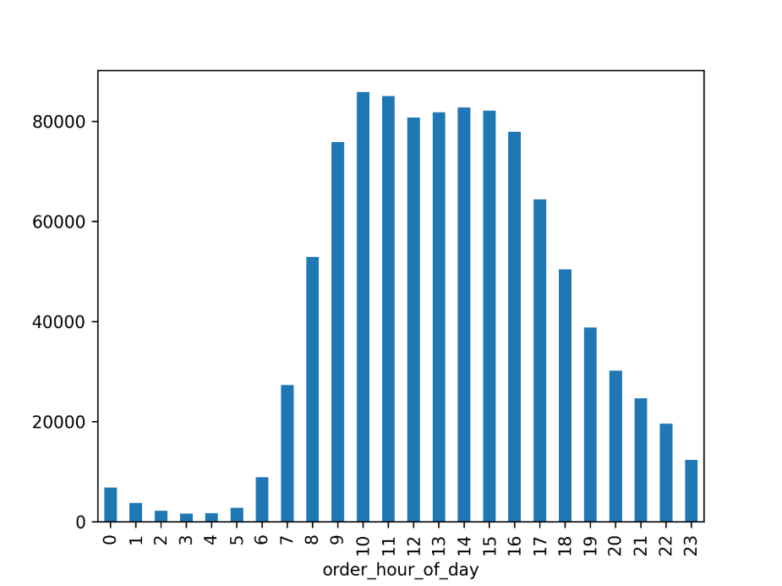
Case Study Four: Instacart Grocery Analysis
I started with the analysis of sales trends, using Python within Google Colab
As we might expect, Instacart are busier at weekends and in the middle of the day.
What was less expected was a big spike in average basket price at 5am. This turned out to be due to sales of Organic Bananas.

Slide 18
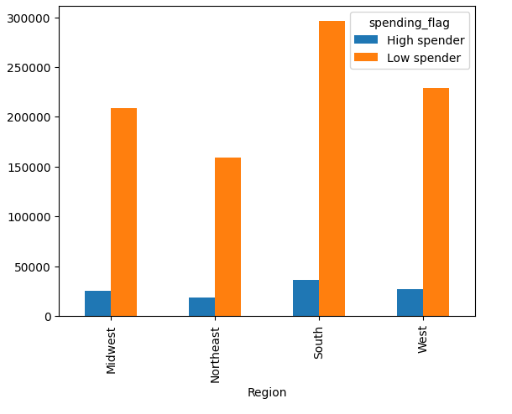
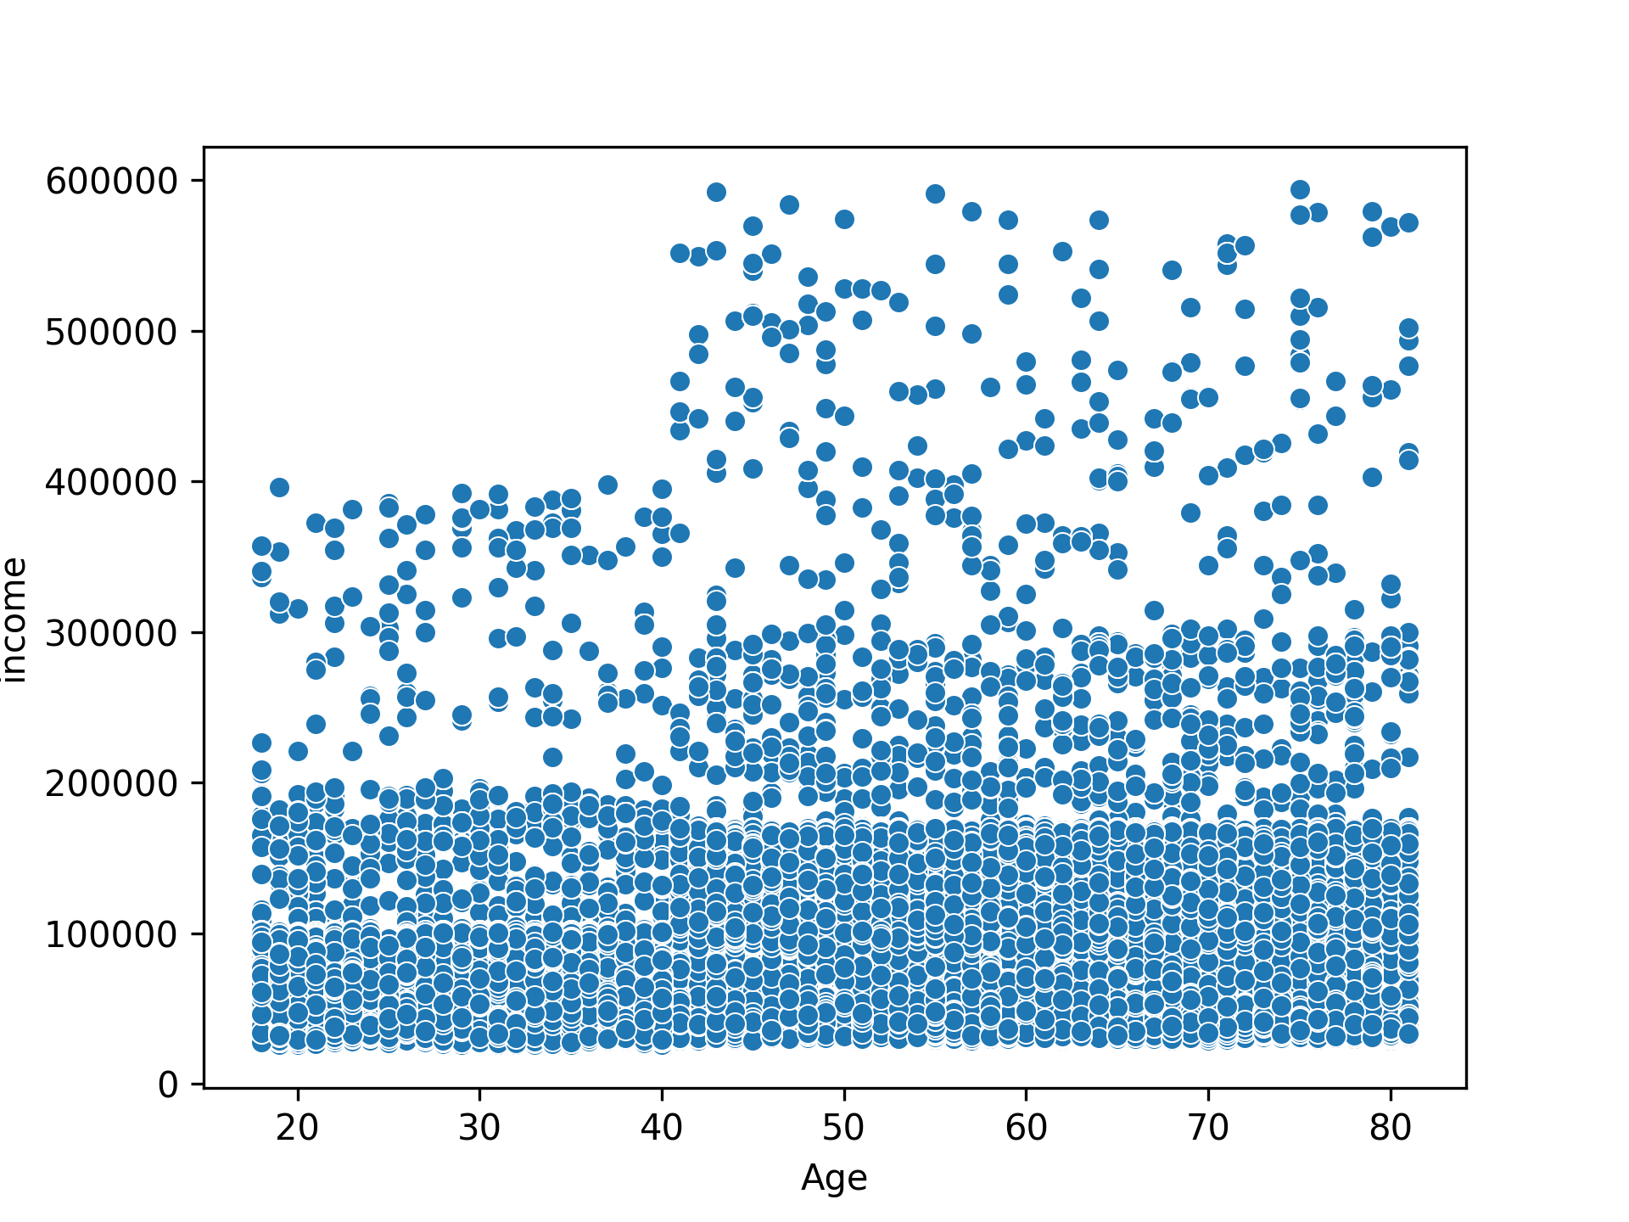
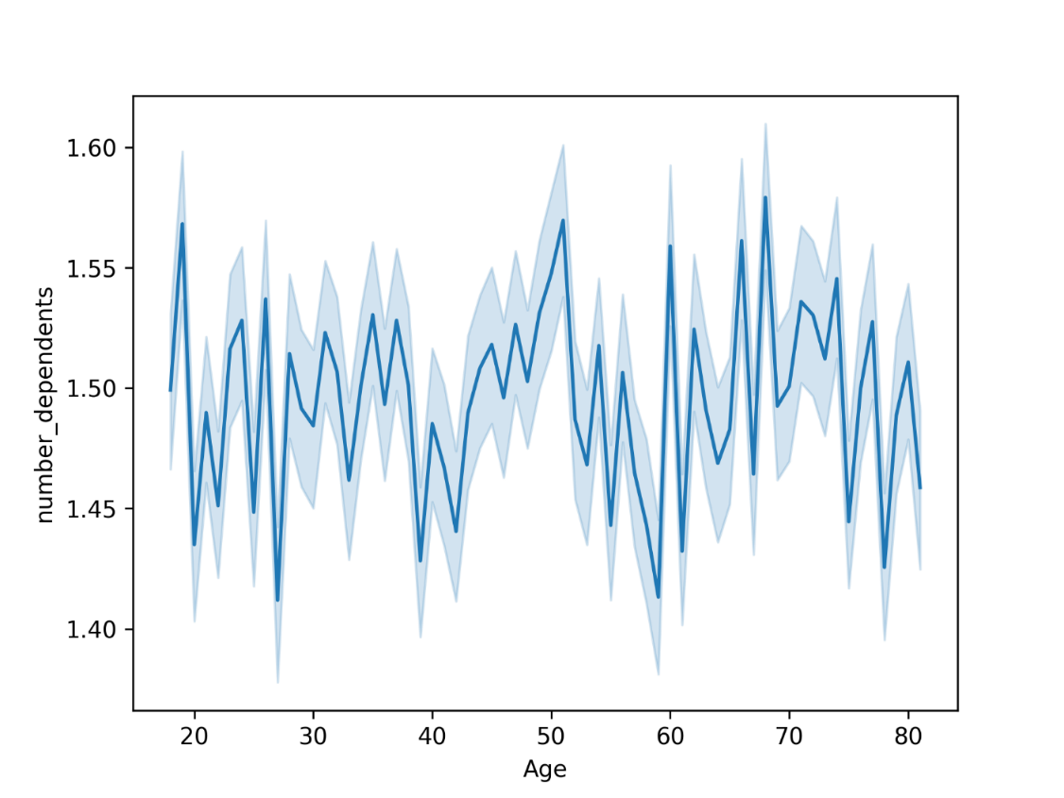
Case Study Four: Instacart Grocery Analysis
More detailed analysis within Colab produced some subtle - but important - trends.
CREATING FLAGS
Having categorised customers with “Spending Flags” we can see that the Northeast looks quite different to the South – less spend, but a greater proportion of high spenders.
SCATTER CHART CORELLATION
There is a higher average income with age, and all of the very highest earners are over 40.
But the core customer base is lower income earners, across all ages.
COMPARISON LINE CHART
We might have assumed that number of dependents would drop off with age – not so – the average number remains fairly constant.

Slide 19
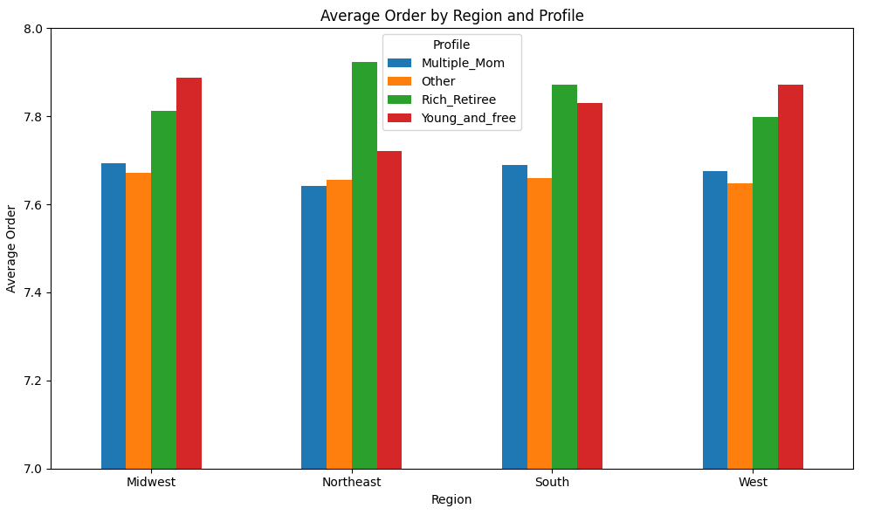
Case Study Four: Instacart Grocery Analysis
Profiling and Analysing Different Customer Types
I identified three profiles that could be of most interest to Instacart.
“Multiple Mom” in fact has a profile very like the average customer
“Rich Retiree” and “Young and Free” spend differently to other customers – but similarly to each other!
They are less interested in value – and buy more alcohol and meat/seafood than other profiles.
My recommendation was to promote these products more to these groups
My caveat was to understand the sensitivities and responsibility required when attempting to increase alcohol sales
See more: |  | Repository
Notes:
See more here:

Slide 20
Case Study Five: AEP Time Series Analysis
I followed an exercise online to learn more about time series analysis.
This exercise gave Python coding to produce charts, I used this and Co-pilot to help me understand and simplify some of the code.
The object of the exercise is to look at energy usage for American Electrical Power over different periods of time.

Slide 21
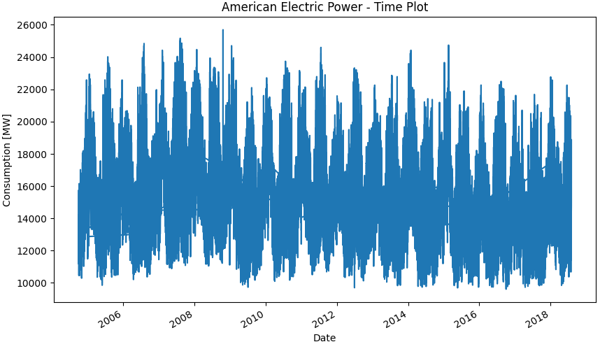
Case Study Five: AEP Time Series Analysis
LINE CHART
This initial plot does show some obvious seasonality, but otherwise there is too much detail to be of real use.
So, the first step was to structure the data to make it more useful

Slide 22
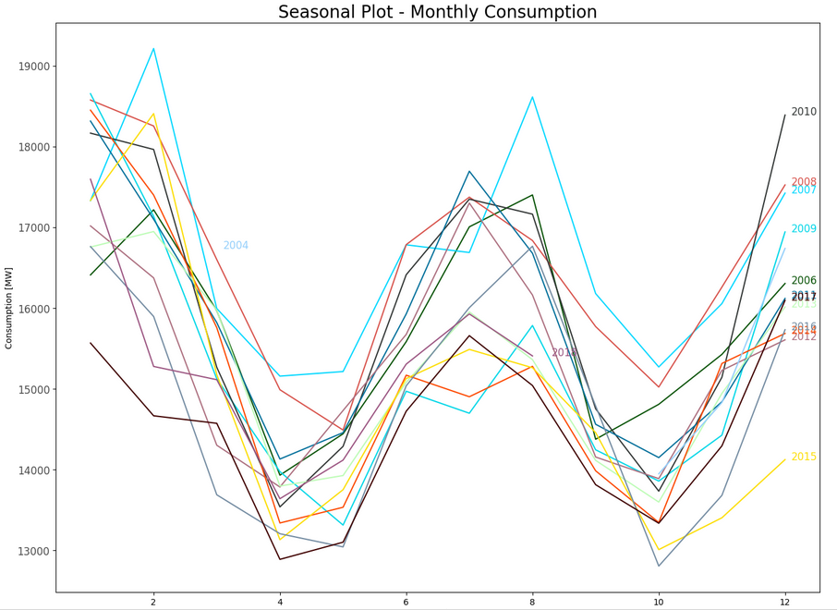
Case Study Five: AEP Time Series Analysis
I created a populated new columns that contained all of the data for each Year, month, day and hour – and that enabled much more detailed and useful analysis.
LINE CHART
While still another line chart of the same date, we can now see tow very important things:
There is the same pattern of seasonality each year – and that will enable forecasting
There is quite a lot of difference in actual power usage between each year – so the forecasting will need to take into account factors other than just the time of year

Slide 23
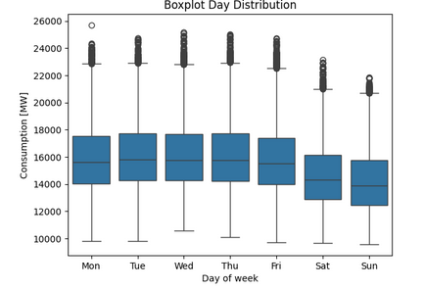
Case Study Four: AEP Time Series Analysis
BOXPLOT
This chart shows two important things:
That usage by day is often very predictable. Consistent in the week and then dropping a little on Saturday and a little more on Sunday.
That you cannot be complacent about demand. ALL of the outliers lie at the top end of the scale – so surges in demand always need to be planned for.

Slide 24
Case Study Six: Test Match Cricket Data
As a project, I sourced my own data, and performed these analyses:
Exploratory analysis through visualizations (scatterplots, correlation heatmaps, pair plots, and categorical plots)
Geospatial analysis using a shapefile
Regression analysis
Cluster analysis
Time-series analysis
Before producing a narrative of my analysis in a dashboard
See more: |  | Visualisation
 |  | Repository

Slide 25
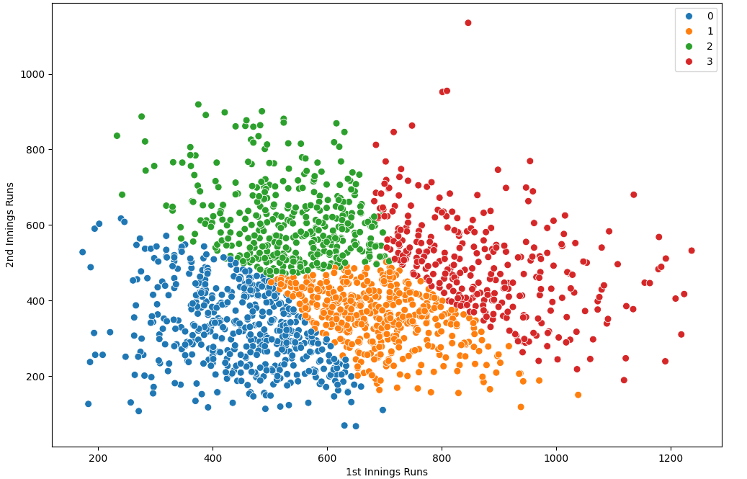
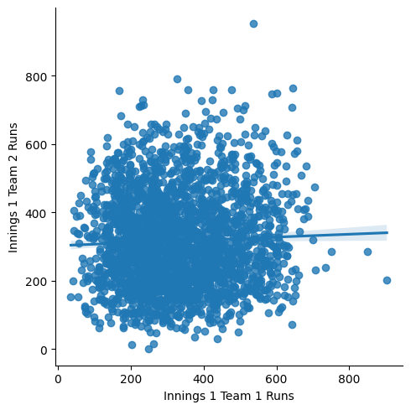
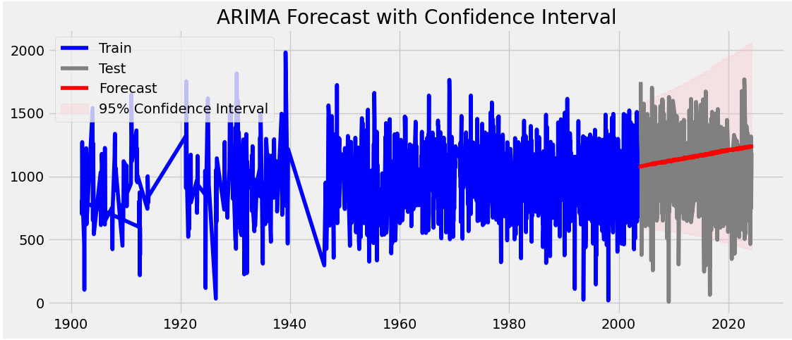
Case Study Six: Test Match Cricket Data
Regression
This regression analysis – surprisingly – showed that there is little relationship between first and second innings scores.
Clustering
Using unsupervised machine learning, I was able to identify there are four main types of Match:
Red: High-Scoring
Blue: Low-Scoring
Orange: Team batting first dominates
Green: Team batting second dominates
Time Series Analysis
I was able to produce an accurate forecast of likely aggregate runs in Test Matches – but also demonstrate that there are so many variables, the forecast may not prove all that useful

Slide 26
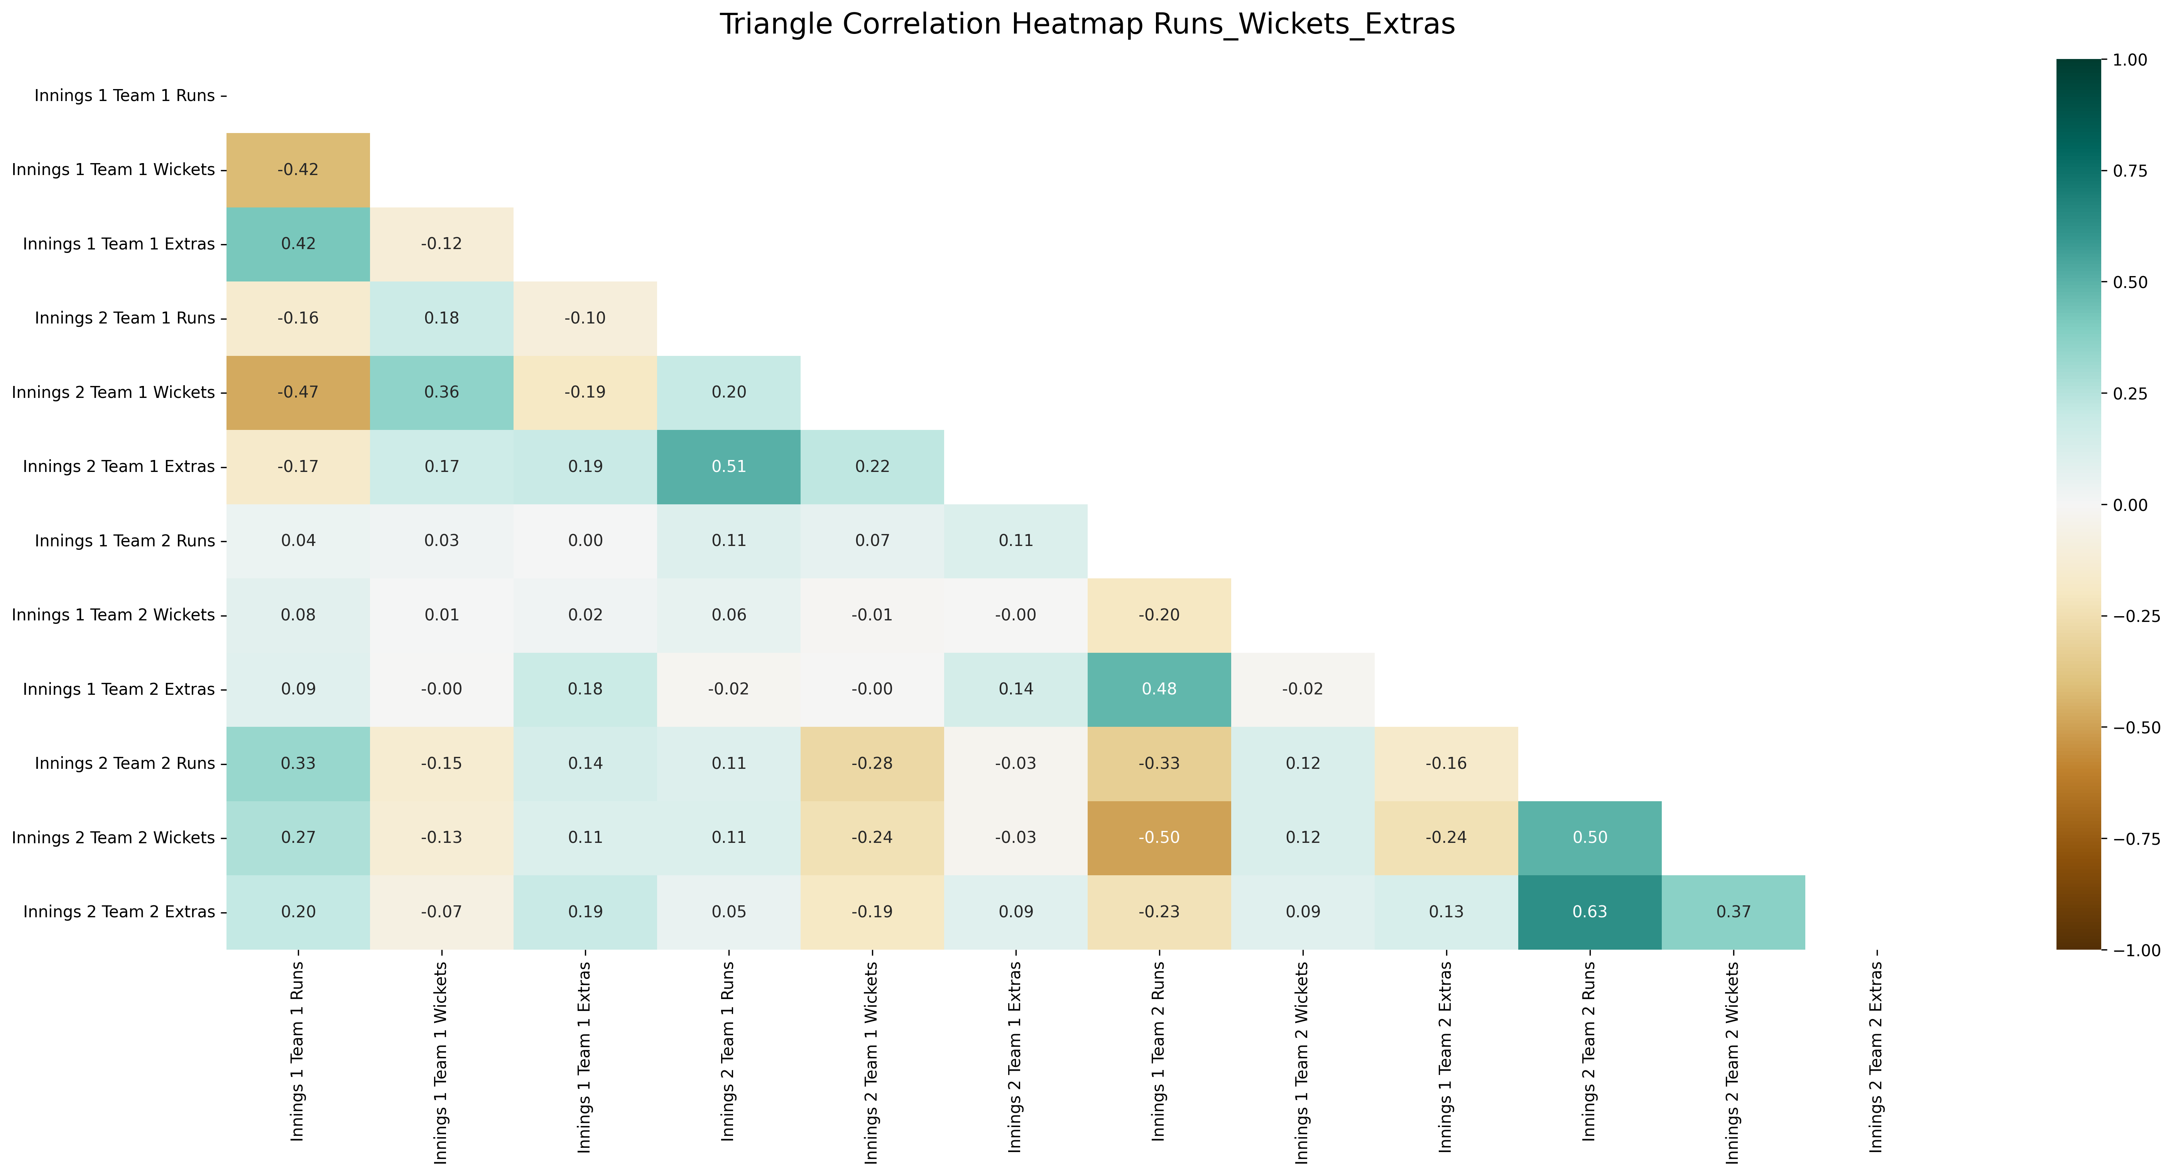
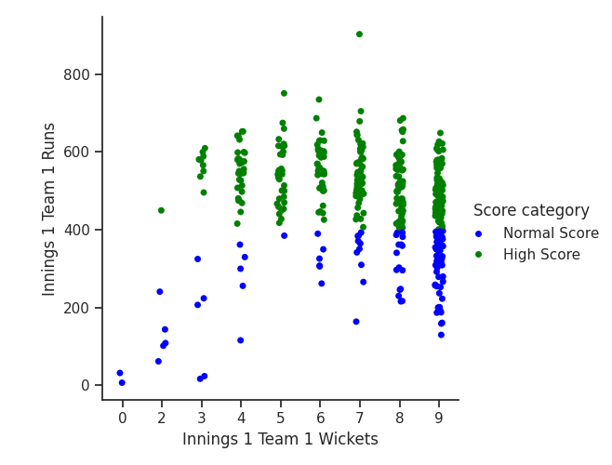
Case Study Six: Test Match Cricket Data
Heatmap
This heatmap showed me the level of correlation between the main variables I had access to.
The strongest correlations were between runs and extras, which wasn’t very interesting.
But the other strongest correlation between runs scored and wickets lost was more interesting.
Scatterplot
This led me to this simple chart that shows that if you don’t lose all your wickets, you’re much more likely to make a high score.
This become my hypothesis.

Slide 27
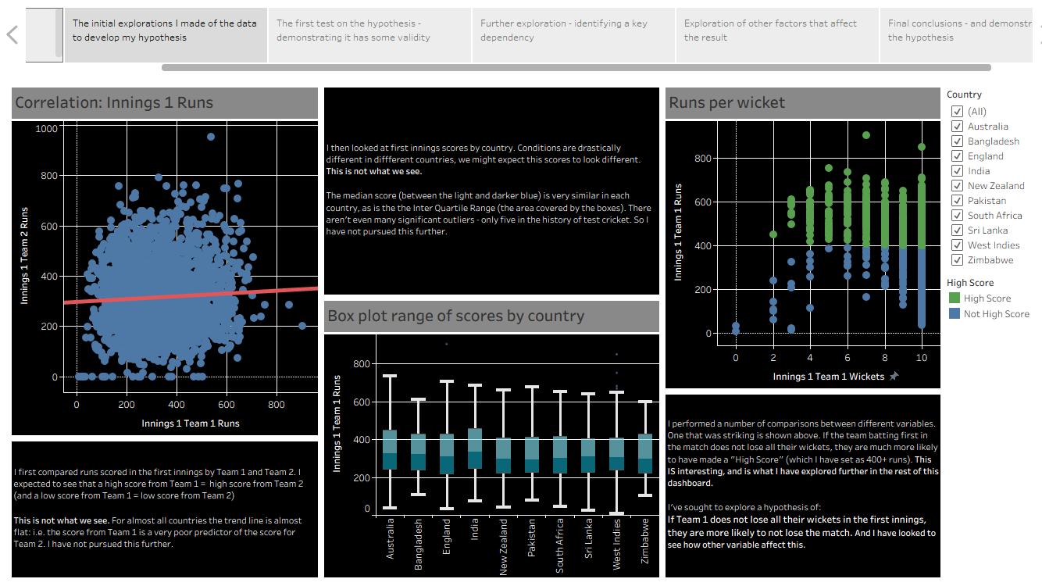
Case Study Six: Test Match Cricket Data
Interactive, Narrative Storyboard
Finally, using Tableau, I created a storyboard where I showed my findings, demonstrated the validity of my hypothesis by exploring it further, and allowed viewers to dig further into the data.
See more: |  | Visualisation
 |  | Repository

Slide 28
Sam Monteath
Data Analysis Portfolio
sam@reasonwhy.uk
github.com/SamMonteath
linkedin.com/in/sammonteath
public.tableau.com/app/profile/sam.monteath/vizzes

